Slide 1
TDD in Angular
Test Driven Development
DEV3LSOLUTIONS.COM
Notes:
10m : 10m
Socialize
---
(TDD Day 3)
8 hours – 1 hour lunch break
1.5 hours = Gilded Rose
5.5 hours = 330 minutes
10-minute break every hour
- Try to break on exercise to catch up anyone

Slide 2
recap
Notes:
15m : 25m
Utilize practice problems (aka Katas) to develop a baseline level of experience with TDD
Fizz Buzz
Roman Calculator
Bowling
Widget Mock
# Three Laws of Test-Driven Development
- You are not allowed to write any production code unless it is to make a failing unit test pass.
- You are not allowed to write any more of a unit test than is sufficient to fail; and compilation failures are failures.
- You are not allowed to write any more production code than is sufficient to pass the one failing unit test.
Fake it till you make it
# ZOMBIES
Z - Zero
O - One
M - Many
B - Boundary Behavior
I - Interface Definition
E - Exercise Exception Behavior
S - Simple
S - Single Responsibility Principle
O - Open / Closed => Open for extension, closed for modification
L - Liskov Substitution => shape.area :: rectangle.area : square.area : circle.area
I - Interface Segregation
D - Dependency Inversion
D - Don't
R - Repeat
Y - Yourself
Y - You
A - Ain't
G - Gonna
N - Need
I - It
---
Code Smells
“Code smells are usually not bugs; they are not technically incorrect and do not prevent the program from functioning.
Instead, they indicate weaknesses in design that may slow down development or increase the risk of bugs or failures in the future.
Bad code smells can be an indicator of factors that contribute to technical debt.”
Refactoring
Restructure (the source code of an application or piece of software) to improve operation without altering functionality
- Implementation and Refactoring should be separate steps
Boy Scout Rule
Read by Refactoring
System Under Test (SUT)
- Isolate Collaborators
- Stubs, Mocks, and Fakes
Simple Design & Emergent Design
- Runs all tests
- No duplication
- Expresses intent
- Minimal number of classes & methods
TDD and Legacy Code… What is Legacy Code?
- Pin Down / Approval Tests
- Seams
- Break Dependencies

Slide 3
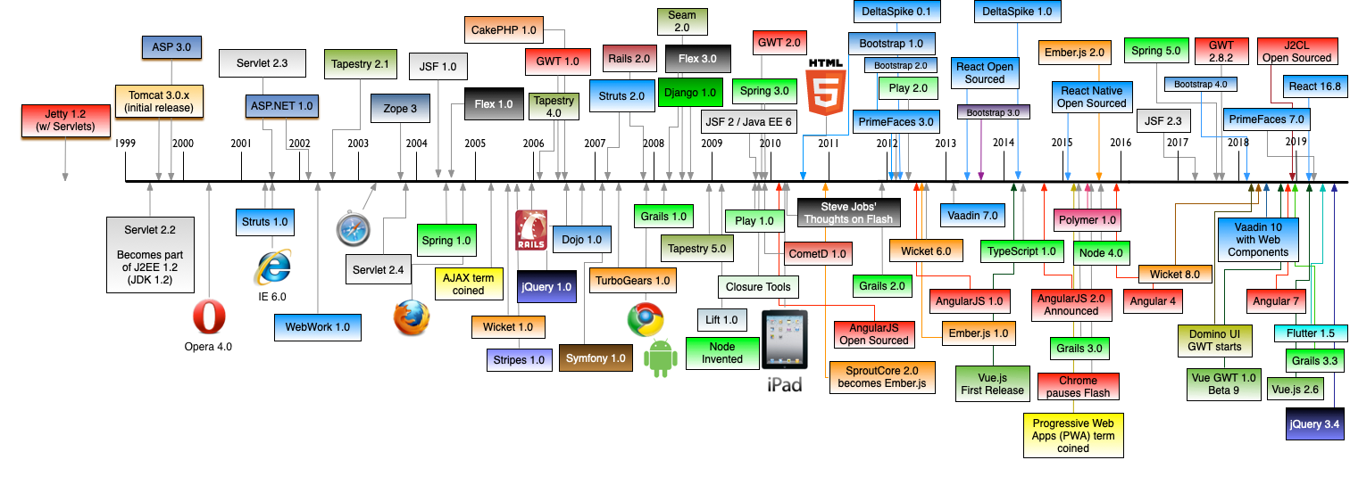
How Did We Get Here?
Notes:
35m : 60m
At first, there was darkness… IMAGINE, a world without the internet
How did we live?
And then January 1st 1983, the internet was born - the TCP/IP protocol was established
And all was text… anyone ever play a MUD?
Telnet was a thing, IRC channels… Primarily used in academic and niche communities
The movie “Hackers” came out in 1995 – if you want a computer sci blast from the past, check it out
JavaScript also releases as apart of Netscape Navigator in December...
Microsoft answers with Jscript in 1996 - Internet Explorer and Netscape had vastly different interpretations of html, cs, and now js
HTTP was developed in 1989, but the first documented version was 1997… little 13 year old me was oblivious to the relevance
- Browser wars…
- ECMAScript language specification in June 1997
- GOOGLE!!! OMG we can search for things in Google, a revolutionary pivot on such result prioritization (most visited) – Ask Jeeves, Yahoo, etc
- The Original FF7 was released in 1997, PS1 - 4 Discs
- Windows 97 shipped with IE4, this is near the end of the browser wars – Microsoft was winning
- AOL was a thing, with internet when you got stuck in a video game you could look it up online!!! GameFaqs was launched in November 1995! Has anyone ever call a game hint hotline before?!?!
- GeoCities and AngelFire! Host your own websites, super excited to have frames!!! CLASSIC era
- Original Skynet doomsday
College 2003 – Java Applets
I don’t see Flash on here, but that was a thing back then… Microsoft had Silverlight as a competitor
2004 Facebook launched (eventually create react, and virtual dom)
I started web development in 2007 (intern)…
It was a glorious time – jQuery had JUST arrived on the scene, but I would have been oblivious to it
You’d write things in Firefox because it had better js debugging support, then try and make it work in IE6/7 - First Real Job used ActiveX, so only supported by IE8
Front automated front-end testing was not a thing… you needed the DOM and browsers were fighting for standards
Google Web Toolkit GWT was an attempt at breaking the dependency of the browser from the implementation – believe it could be tested, but I did not ever hear or see anyone doing automated here… mostly just complaining how bad it was, but not as bad of vanilla js of course!!
Dojo was a competitive solution to jQuery – caked into IBM WebSphere Portal by default (Portlets were supposed to be so cool!) – SPA’ish?
Google Chrome released in 2008 – V8 JavaScript engine smoked the competition - JIT
Around the end of 2009 / early 2010 an explosion of frameworks began… it was a great time! iPad, Node, Backbone, Angular 1.0, Ember
And things were good – it was wild… everyone was fighting to create a standard – the concept of a SPA became common place
In my GitHub repo, if you look in my archived project there are some Angular 1x toy projects, I was waiting for the opportunity to use something, anything ”Ha, your web page flickers” #spa
I worked at Western Reserve Group, which is when I was introduced to Lean Dog – I believe one of their first clients… Amy “John’s Pair” Koran, was my FIRST qa – she was and continues to be a fantastic mentor to this day
Lean Dog had moved on by the time I got there, but first real introduction to formal Agile Methodologies – After 4 years of more traditional waterfall, it was amazing – Looking back now, the legacy java web apps I worked on were more like iterative waterfall with semi or annual releases… The new auto product team was using .net and scrum
MTD Products I saw Dojo, and hated it – it was like the Google+ competitor to jQuery
THEN!
Early 2013 React was open sourced… Enter the Virtual DOM
React decoupled the manipulation of the DOM from the Browser (boom)
Angular what? The next year Angular2 announced, but they might as well have named it something else!
There was space for a macro front end framework, and Angular wanted to position itself to be the top competitor in the space
The virtual dom (and other industry insights) were incorporated
2014 at Explorys I was on the Shared Services and Security team, we had a ingrown js framework we affectionately labeled TommyJs (Tommy created it) on top of a Ruby on Rails app and… ATDD!!! – TommyJs had flavors of backbone, dependency injection, dynamic binding and models… but its own conventions for everything… IT WAS TERRIBLE, when I first started, it took me days to add a checkbox to a page to “Show Password” within the password reset flow… We rotated teams, and a majority of the
– LEAN DOG was here again! Right before I arrived their engagement had ended again)... I actually took the ATDD course I tought last week during this time
Up through present, it seems like JS frameworks proliferate like rabbits… every 3-6 months someone has a new js framework, macro and micro alike
We are standing on the shoulders of exponential growth – frameworks burn like a super nova, and explode just as violently… #Betamax
Mentioned TurboGears, 2015 I started a company called OnShift which had chosen this as their Python Macro Framework (like Ruby on Rails), which it turns out TurboGears lost to Django – and thus was no longer in active development or support
We had backbone, we started using React – Docker was a thing
Since then I have had many years of professional experience in React, React Native, and more recently Angular
In the last three years ad an independent contractor, I have helped tweak things on Angular applications for clients, but I have not scaled to any significant size on my own or within a team – legacy maintenance pays the bills well
I’ve read books, taken tutorials, and made a couple toy apps – so most of you probably are beyond my level of competency in Angular
2021 - New Skynet Doomsday, where is Skynet? How else can we solve our JS problem?
20210930 - Today the most current version of Angular is 12.1.4, released July 28th 2021

Slide 4
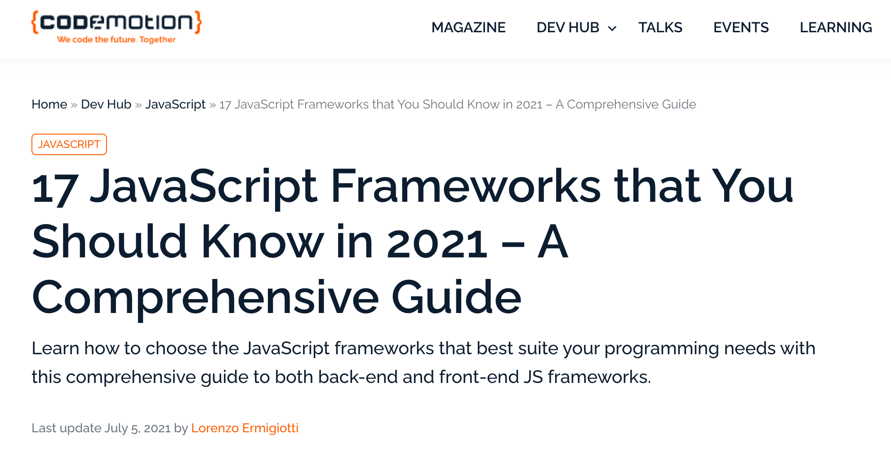
Notes:
0m : 60m
Really, only 17?

Slide 5

Notes:
5m : 65m
#1. Angular
#2. Vue JS
#3. Next JS
4#. React JS
5#. Ember JS
6#. Svelte JS
7#. Gatsby JS
8#. Nuxt JS
9#. Bootstrap

Slide 6
BREAK
skynet?
https://www.youtube.com/watch?v=fn3KWM1kuAw
Notes:
10m : 75m
38 years ago the internet was born, now we have dancing robots…
https://www.youtube.com/watch?v=fn3KWM1kuAw

Slide 7
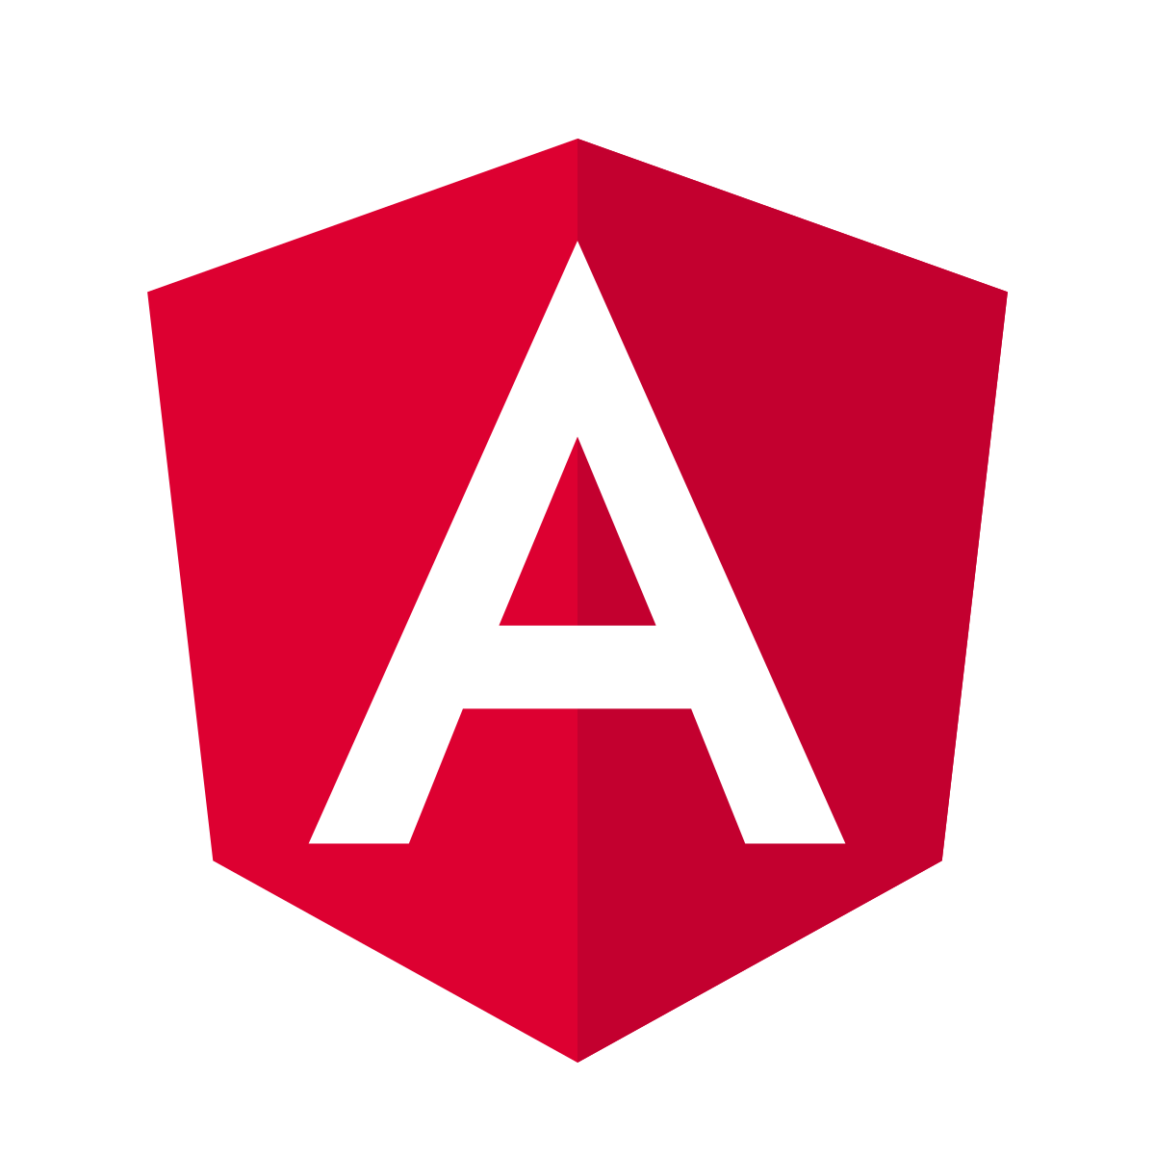
What is Angular?
Angular is a JavaScript framework for building single-page client applications using HTML and TypeScript. It is primarily written in TypeScript and implements core functionality as a set of TypeScript libraries that you import into your apps.
Notes:
2.5m : 78.5m
Cross Platform
Native applications using Cordova, Ionic, or NativeScript
Built with Speed, Performance, and Productivity in mind
CLI, Templates, and IDEs
Developer Focused:
- Testing with Karma

Slide 8
Angular Features
- Custom Components - Data Binding - Dependency Injection - Testing - Comprehensive
Notes:
2.5m : 80m
Custom Components Angular enables users to build their components that can pack functionality along with rendering logic into reusable pieces. Data Binding Angular enables users to effortlessly move data from JavaScript code to the view, and react to user events without having to write any code manually. Dependency Injection Angular enables users to write modular services and inject them wherever they are needed. This improves the testability and reusability of the same services. Testing Tests are first-class tools, and Angular has been built from the ground up with testability in mind. You will have the ability to test every part of your application—which is highly recommended. Comprehensive Angular is a full-fledged JavaScript framework and provides out-of-the-box solutions for server communication, routing within your application, and more.
---
Browser Compatibility
Angular works cross-platform and compatible with multiple browsers. An Angular application can typically run on all browsers (Eg: Chrome, Firefox) and operating systems, such as Windows, macOS, and Linux.
Now that you’re familiar with Angular, in the next segment, you’ll learn about the prerequisites for creating an Angular HelloWorld Application.

Slide 9
Angular Prerequisites
node - `node --version` Angular CLI - `npm install -g @angular/cli` - `ng --version`
Notes:
5m : 85m
Node / Angular CLI
Angular CLI is a command line utility that helps developers scaffold Angular Applications

Slide 10
Angular Hello World
``` ng new hello-world N # no angular routing CSS # style * Installing packages (npm)... cd hello-world ng serve ```
01_hello_world
Notes:
0m : 85m

Slide 11
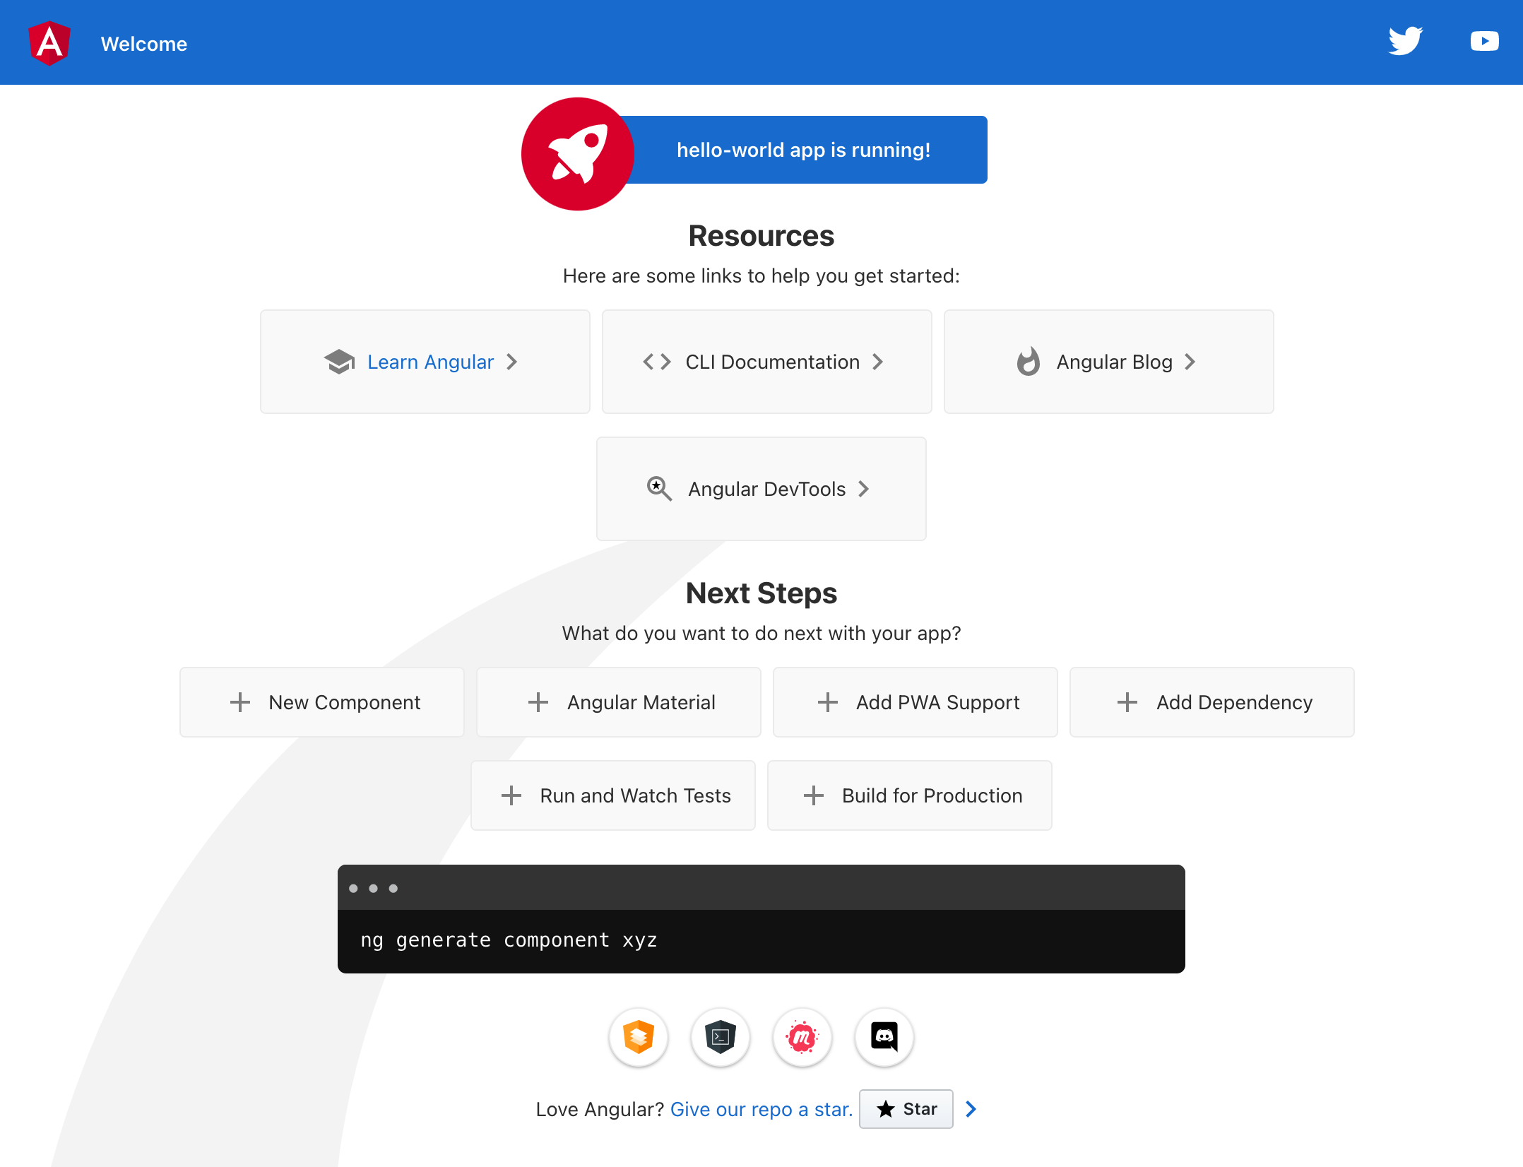
01_hello_world
Notes:
20m : 105m
Go over boilterplate
- angular.json – configuration, added: ` "codeCoverage": true` to “test”.”options” - environment based configuration, prod / dev - Config for app pointed at src/main.ts and pollyfill.js
- Config for test pointed at src/test.ts and pollyfill.js
- TestBed Configures and initializes environment for unit testing and provides methods for creating components and services in unit tests.
- Test naming convention, `.spec.ts$` - Global stylesheet
index.html --> `<app-root></app-root>` Browser tab title
Don’t forget the favicon.ico!
assets - images / etc
evnrionments
`npm run watch` for development
`app` is a component, in this case our root component - app.module.ts - define the root component - used in main.ts
- app.component.ts @Component important, decorator - selector : how we access the component in our templates - templateUrl : path to template - stylesUrl: path to styles AppComponent - one attribute named “title” with a value of ‘hello-world’ - app.component.css - app.component.html - bunch of boiler plate, fancy landing page - {{ title }} interpolate title from app.component.ts

Slide 12
Angular Testing
``` npm run test ```
01_hello_world
Notes:
5m : 110m
Really… HOW COULD IT BE SIMPLER?!
When I first ran it, I assumed it was boiler plate and stubs… Nope, it’s actually covering and asserting with examples

Slide 13
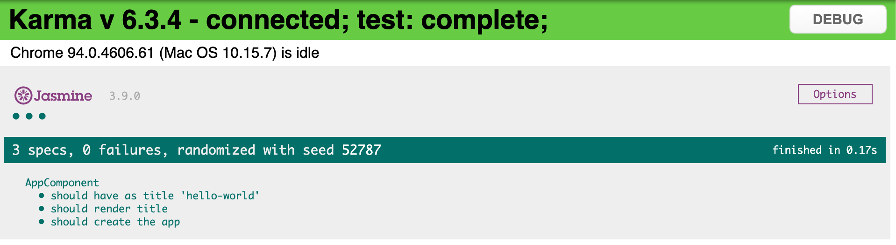
Angular Testing
01_hello_world
Notes:
5m : 110m

Slide 14

Notes:
0m : 100m
Did you guys bring me in here just messing with me?

Slide 15
Code Coverage Enforcement
``` coverageReporter: {
dir: require('path').join(__dirname, './coverage/<project-name>'),
subdir: '.',
reporters: [
{ type: 'html' },
{ type: 'text-summary' }
],
check: {
global: {
statements: 80,
branches: 80,
functions: 80,
lines: 80
}
}
} ```
01_hello_world
Notes:
5m : 115m
Coverage enforment is a double edged sword
Why would this be good and bad?

Slide 16
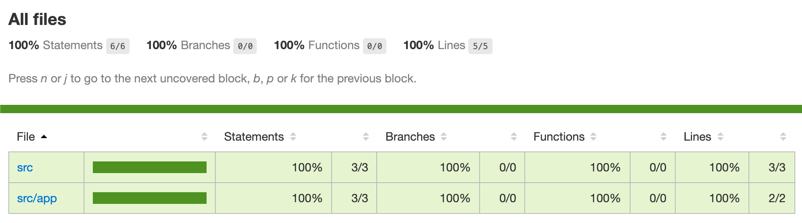
Code Coverage Enforcement
01_hello_world
Notes:
0m : 115m

Slide 17

Notes:
20m : 100m
Did you guys bring me in here just messing with me?
What could Angular have done to make it easier?

Slide 18
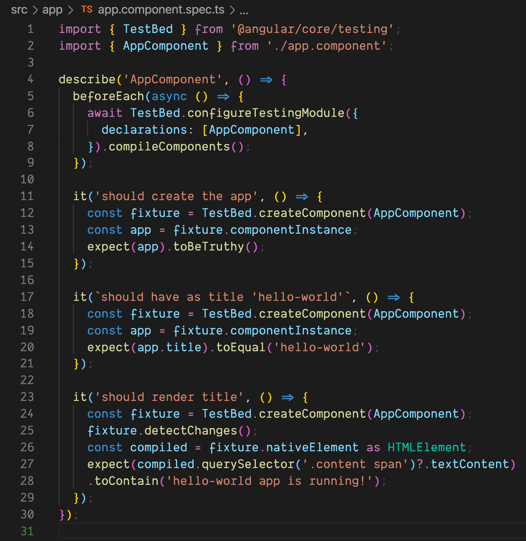
App Component Spec
01_hello_world
Notes:
15m : 130m
So what is going on here?
- beforeEach : compiling components - should create the app - get this instance of the AppComponent and assert it is truthy (it compiles) - isn’t this boilerplate that could be included with EVERY component? - should have as title - the AppComponent implementation contains a title called ‘hello-world’ - testing the behavior of the component - should render title - build the component and get to the virtual dom rendered - select the .content span (if it exists) and then the text
- it should contain ‘hello-world app is running!’

Slide 19
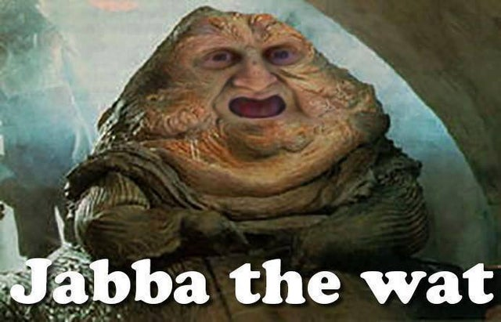
01_hello_world
Notes:
5m : 135m
Does anything in there make you go ‘wat’?

Slide 20

BREAK
Notes:
10m : 145m

Slide 21
TDD Tour of Heroes
Angular is a JavaScript framework for building single-page client applications using HTML and TypeScript. It is primarily written in TypeScript and implements core functionality as a set of TypeScript libraries that you import into your apps.
Notes:
2.5m : 78.5m
Cross Platform
Native applications using Cordova, Ionic, or NativeScript
Built with Speed, Performance, and Productivity in mind
CLI, Templates, and IDEs
Developer Focused:
- Testing with Karma

Slide 22
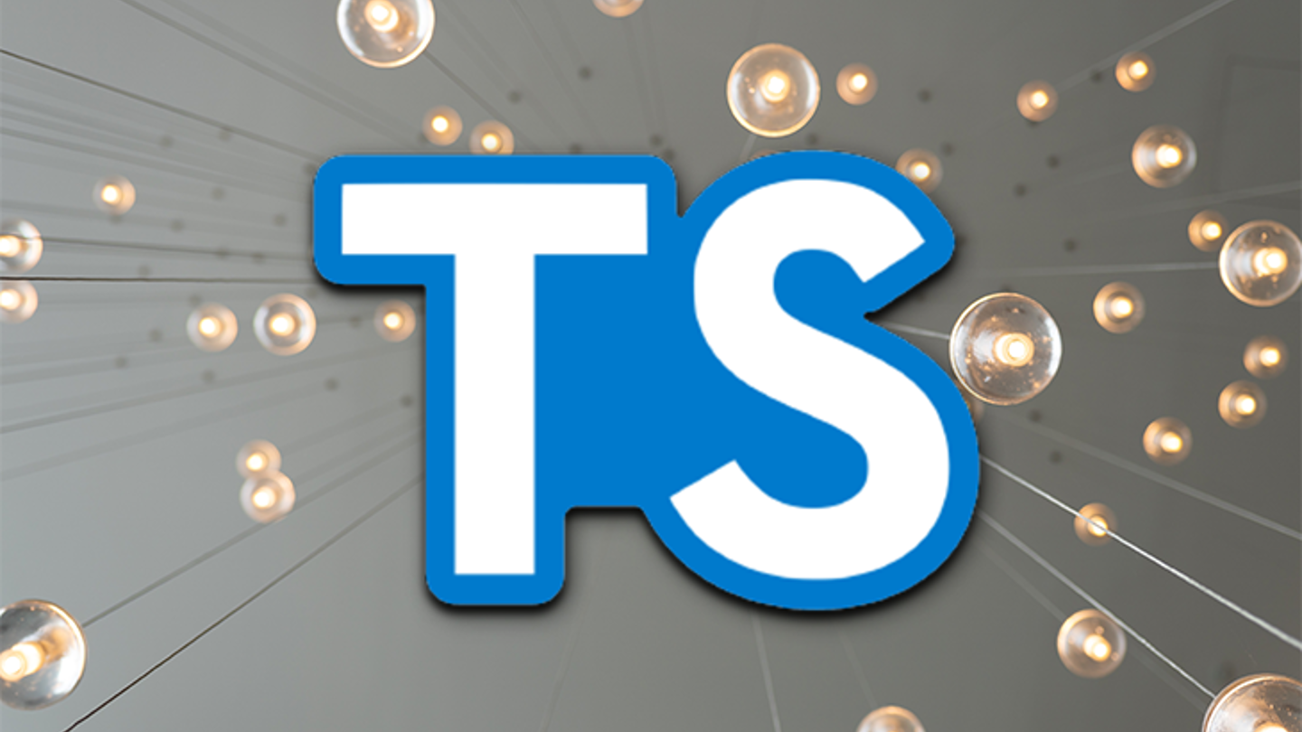
TypeScript Overview
00_typescript
Notes:
15m : 85m
Make sure everyone has computer configured and runnable.
If we run into problems, pair up and resolve the problems at lunch time.
Review TypeScript.
Walk before you run.
How can we get started?
Make sure everyone can run TypeScript

Slide 23
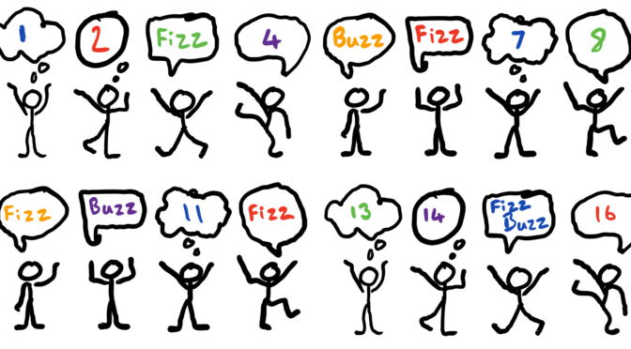
Kata: Fizz Buzz
01_fizz_buzz
Notes:
30m : 115m
http://codingdojo.org/kata/FizzBuzz
Has anyone here ever done FizzBuzz?
Has anyone here ever done FizzBuzz using TDD??
Discuss problem – give hint about the modulo operator “%”

Slide 24

Review
Notes:
10m : 125m
What went well?
What didn’t go well?
Look at some solutions
What if we wanted to use classes?
What if we wanted to use only a function?
What if we didn’t want to use any for loops?

Slide 25

BREAK 1:00
Notes:
10m : 135m

Slide 26

Review
Notes:
15m : 210m
Was that different than how anyone else implemented their Fizz Buzz solution?

Slide 27

BREAK 2:20
Notes:
10m : 220m (Lunch)

Slide 28

BREAK
Notes:
10m : 290m

Slide 29

Review
29
Notes:
15m : 350m
Review class solutions
A little bit more complicated than Fizz Buzz…
Did unit tests help you out in any way?
What if another character number type was added?
Would you be confident you could update your solution to accommodate?

Slide 30

Review
Notes:
15m : 105m

Slide 31

BREAK
Notes:
10m : 115m

Slide 32

Review
Notes:
5m : 175m
Was that different than how anyone else implemented their Fizz Buzz solution?

Slide 33

BREAK
Notes:
10m : 185m

Slide 34

BREAK
Notes:
10m : 250m

Slide 35

Review
Notes:
5m : 270m
How was that implementation different than the rest of our Fizz Buzz solutions so far?

Slide 36

THE END
Notes:
30m : 420m
Course Objectives:
Summarize the value of TDD
Use TDD to solve Katas
Integrate TDD Into Daily Work
Recognize the benefit of writing clean, maintainable code
Going Forward:
Team determines policy going forward
“All new code written using tests”
“Code without tests must be inspected”
Concentrate on legacy code that is causing problems or is the most difficult to modify
Consider pairing
Helps ingrain techniques
Ensures adherence
Final Thoughts: TDD is here to stay
A satisfying and enriching practice that can dramatically increase the quality of your application
Diligent adherence to practice is required to succeed
But the benefits are worth it
Retrospective?

